Slide 1
SysKit Insights
SharePoint Monitoring & Troubleshooting

Slide 2
SysKit is a software development company based in Zagreb, Croatia, Europe founded in 2009. We create innovative software solutions for SharePoint, Office 365, SQL Server, MS Windows RDS, and Citrix admins and consultants.
Technology Partners

Slide 3
Customers
More than 3000 customers in more than 50 countries worldwide use our products!

Slide 4
SysKit Insights
Product Overview

Slide 5
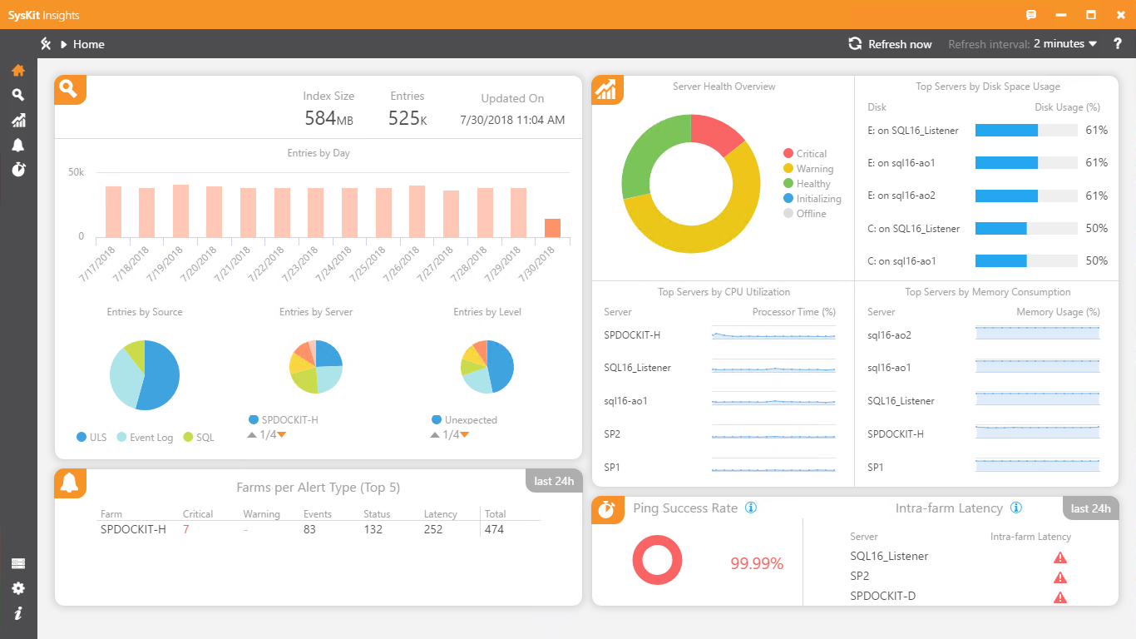
What is SysKit Insights?
SysKit Insights is the tool for monitoring SharePoint performance and troubleshooting your servers via ULS logs, SQL logs, and Windows Event logs.
SysKit Insights allows you to monitor performance across all servers and farms from a single centralized location.

Slide 6
BENEFITS:
Centralized overview of all your farms and servers in a single location
Easy bottleneck identification, quick and precise troubleshoot of the ULS logs
Up to date state of your servers and mission critical performance counters
Real-time email intelligent alerting, will minimize and downtime

Slide 7
Features Overview

Slide 8
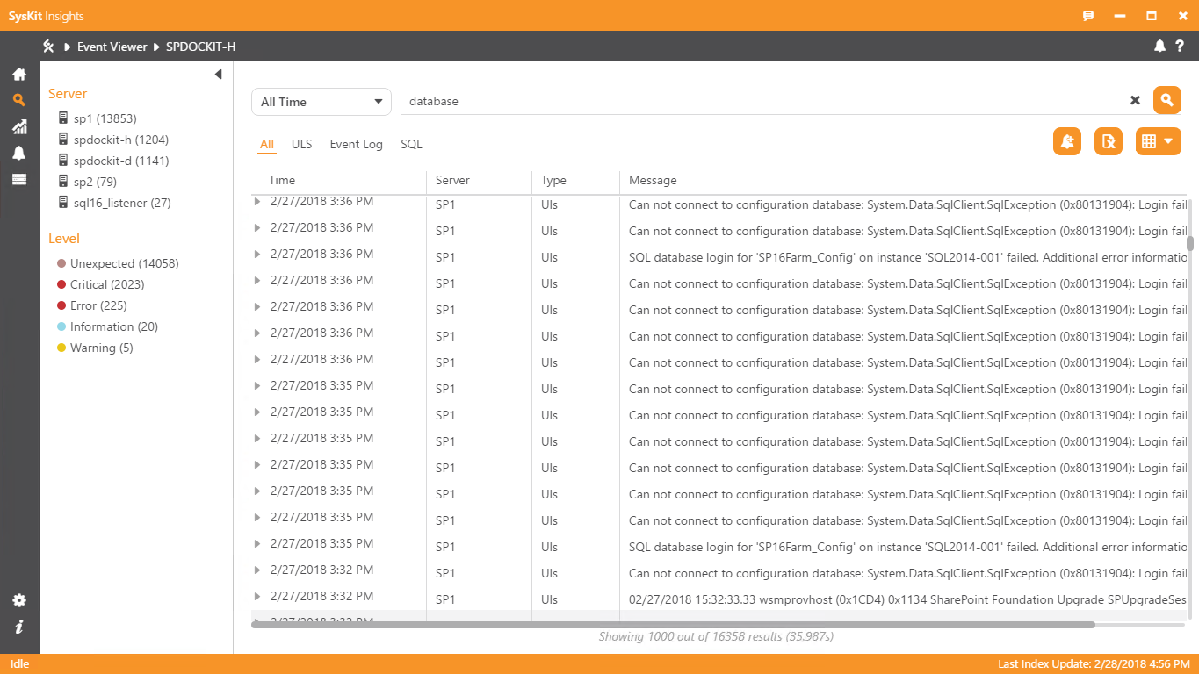
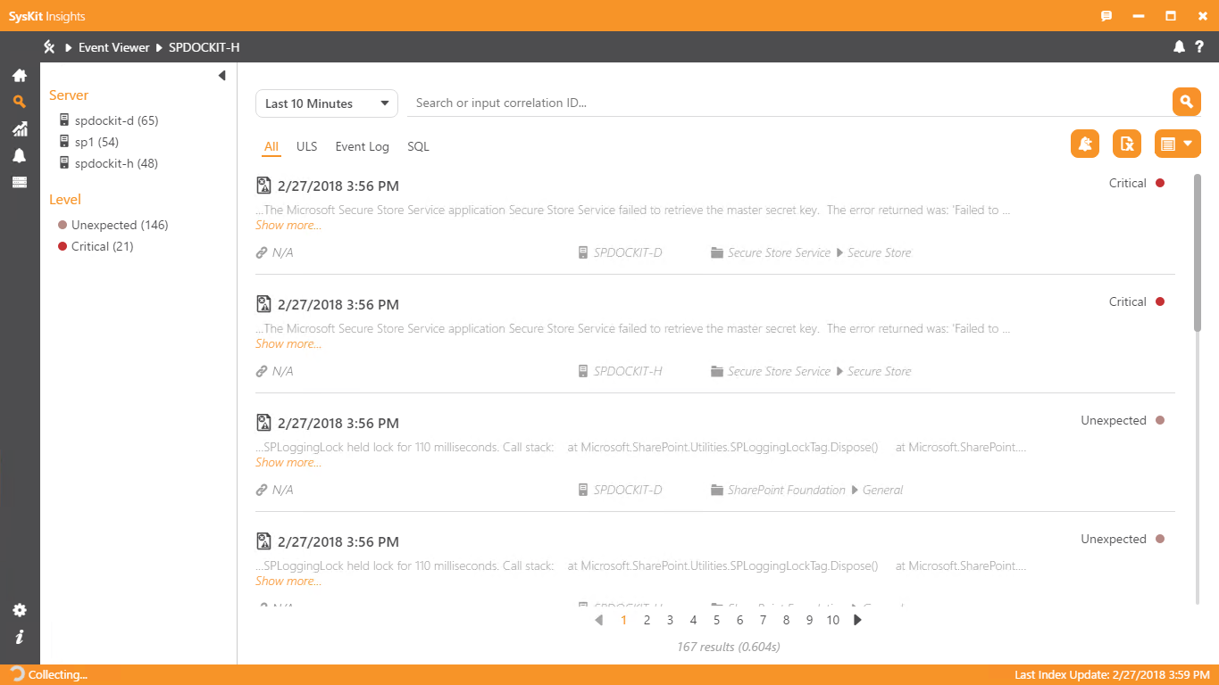
Centralized Event Viewer
SysKit Insights has a powerful collecting engine that gathers ULS, SQL and Windows Event logs from all farms and servers in a single location.
SysKit Insights enables you to:
Search, filter and export all logs for a specific server or a farm
Query data by correlation ID, event ID, server, source or category
Receive proactive alerts if specified event occurs

Slide 9
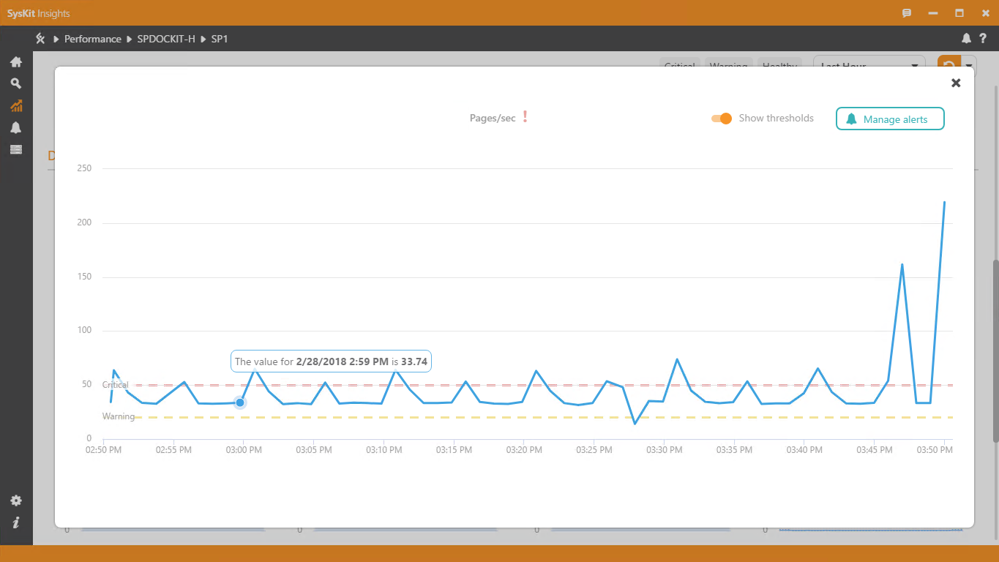
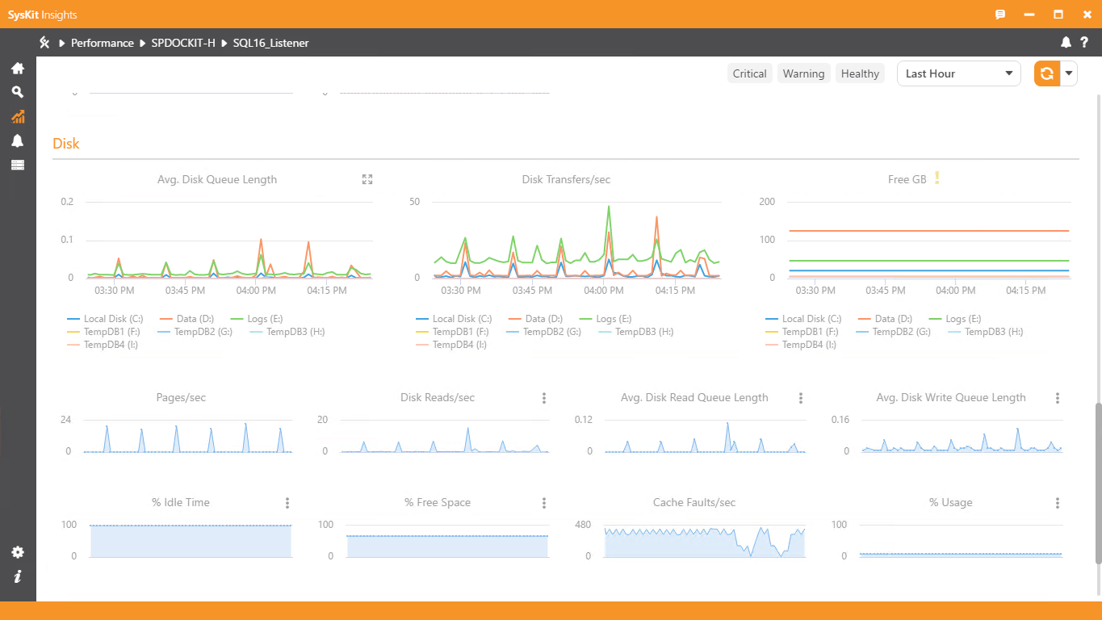
SharePoint Performance Monitoring
Insights allows you to monitor 30+ SharePoint specific performance counters for all servers across all farms. Check out the performance of each farm, or drill down and examine each server individually.
Performance monitoring helps you:
Keep an up to date overview of all servers and farms states
Detect all warning level or critical issues
Identify protentional bottlenecks
Predict future trends

Slide 10
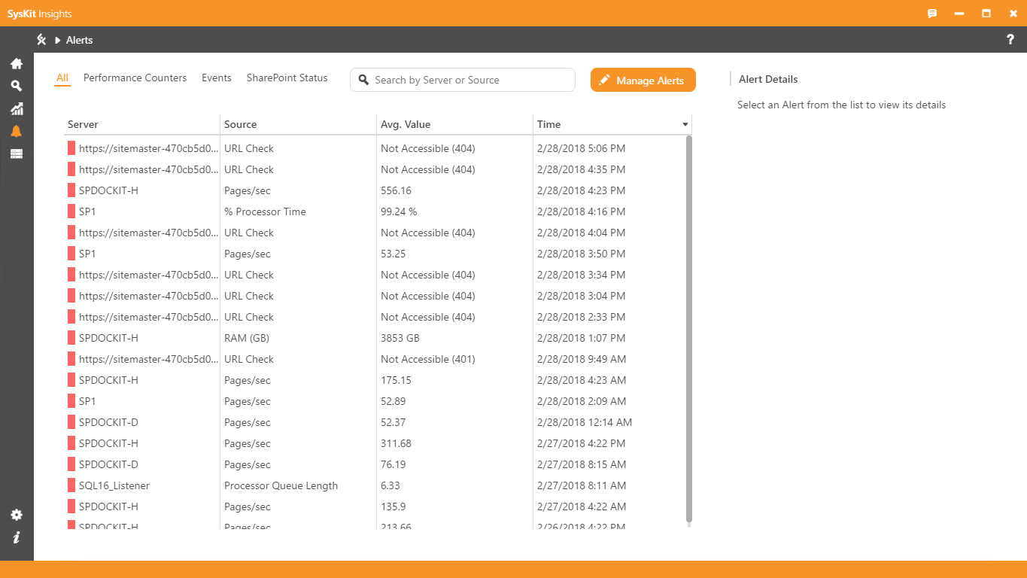
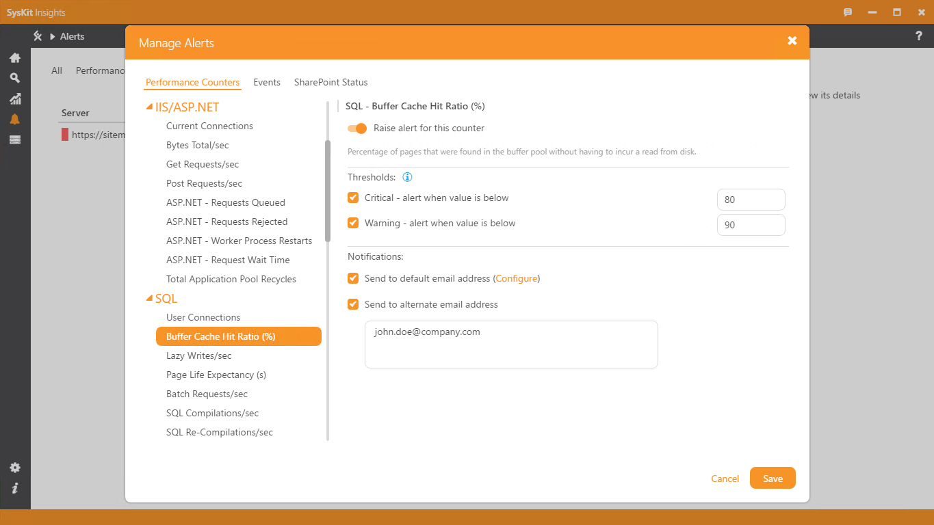
Intelligent Alerts
Insights' intelligent alerting system monitors server performance, SharePoint status, and all relevant SharePoint Events so it can proactively alert you to any potential problems.
Get an instant email notification for any potential issue, such as:
SharePoint downtime or service stopping
Specific error log occuring
Performance counters reaching critical treshold

Slide 11
Web Browser Access
You can use SysKit Insights in Google Chrome in all its glory.
It offers the same functionality that you have in your desktop app with the added benefit of being able to simply share URL of a report or a graph with your colleagues.

Slide 12
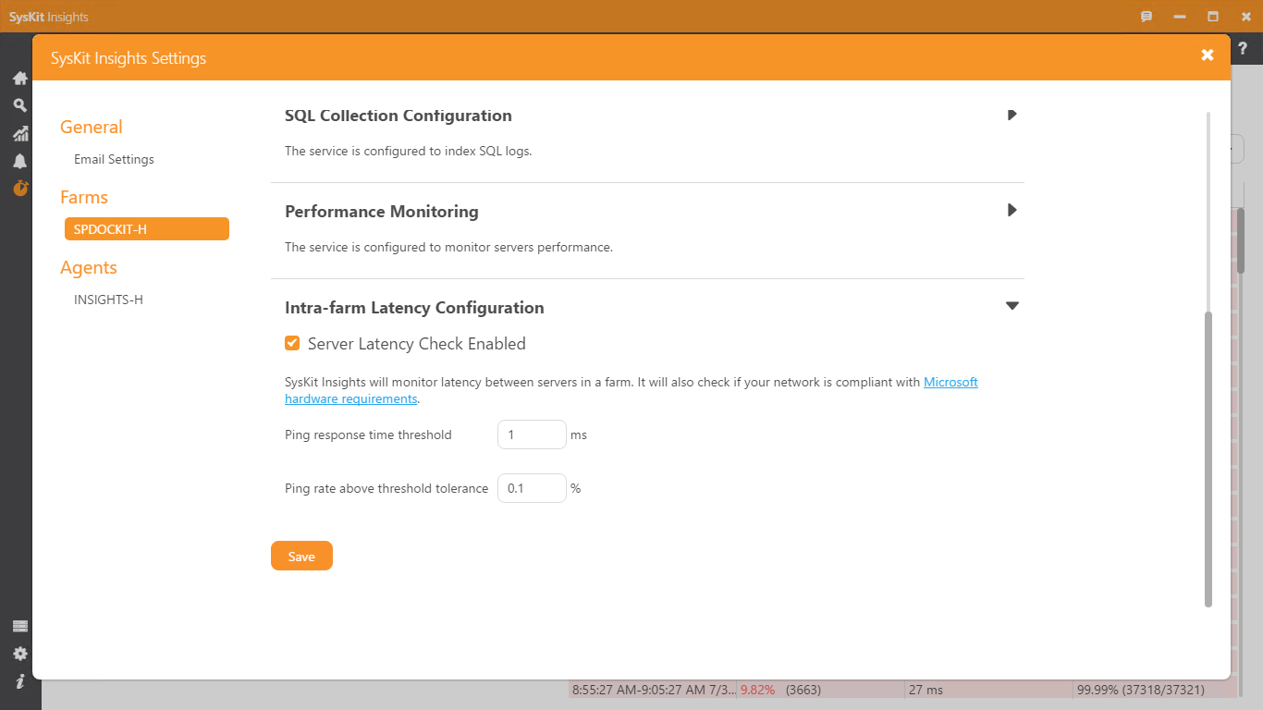
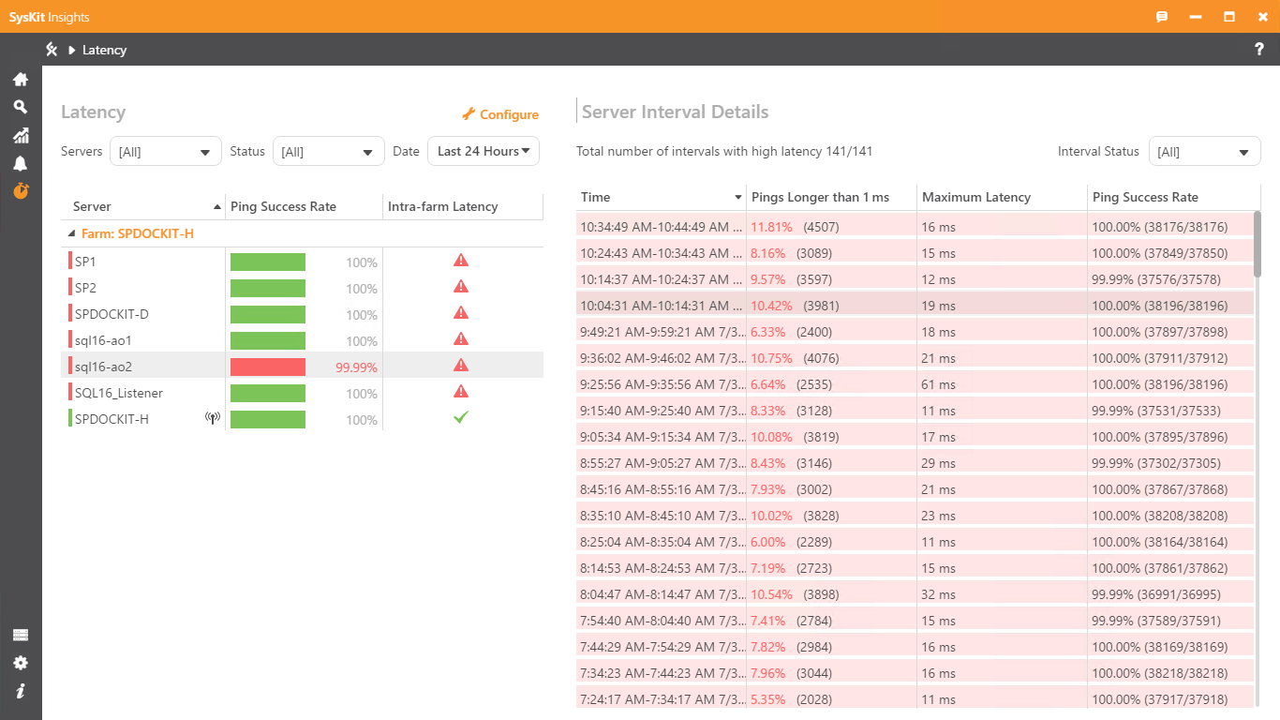
SharePoint Intra-Farm Latency Monitoring
Microsoft requires that your latency is less than 1ms, 99,9% of time in a 10-minute period.
SysKit Insights will constantly monitor your latency and alert you if it’s subpar. This way you will instantly know if an error occurs or your network/virtualization teams degrade the underlying layer.

Slide 13
Support

Slide 14
Customer Support
Super friendly, always ready and free of charge!
*Statistics are collected by 3rd party from the last 100 customers that used our service. Powered by Zendesk
Phone:
USA: (855) 855-5071 Int’l: +1 (631) 406-4900 EU: +44 (0)20 3322-2034
Email:
support@syskit.com
sales@syskit.com
Chat & Web:
www.syskit.com

